Slide 1
Dark Matter
and
Galactic Rotation Curves
The Local Group
Gani, Nicholas, Marie

Slide 2
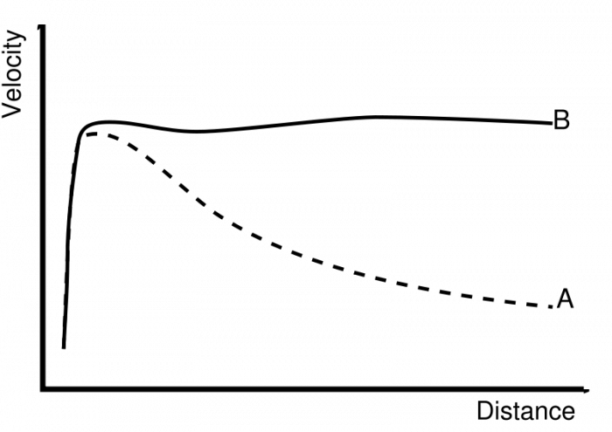
Expected (A) vs Observed (B) Curves
Well, THAT’S a discrepancy!

Slide 3
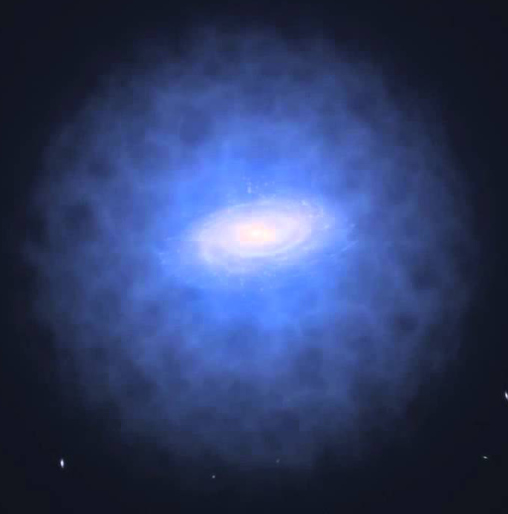
Introduction
Task: Like the astronomers in the past, we must develop a formula that can accurately predict the velocities of stars based on how far they are from the galactic center.
However, the rotational curves that astronomers observe are not consistent with the initial mathematical predictions generated from observable matter alone. Some other matter must be exerting a gravitational force — dark matter.
(Invisible) Dark Matter Halo

Slide 4
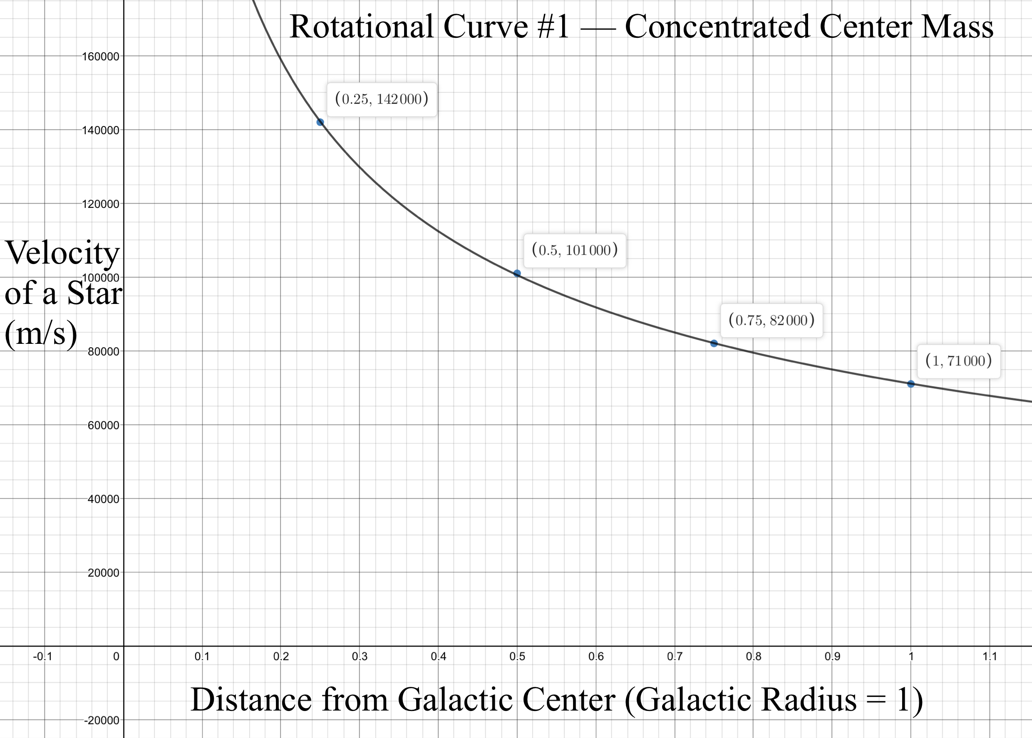
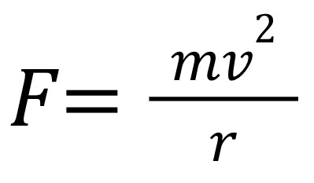
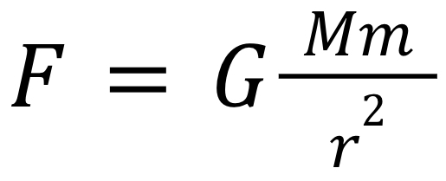
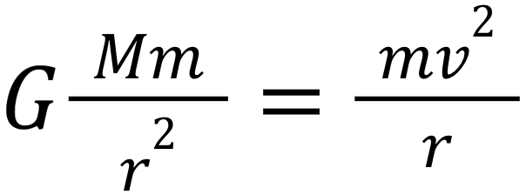
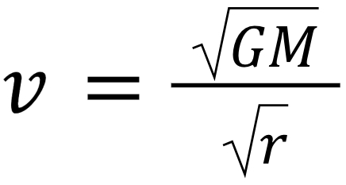
Model A
Concentrated center mass of 10¹⁰ solar masses with negligible mass (i.e. stars) orbiting center in circles
Centripetal force formula:
Newton’s Law of Universal Gravitation:
Centripetal force is gravity, so set Fs equal:
Solve for velocity:
Inverse Relationship
A star orbiting the galactic center from farther out will have a smaller velocity than a star closer in
Model A mostly reflects scientists’ previous theoretical models, but is inaccurate in the actual universe
Algebra!

Slide 5
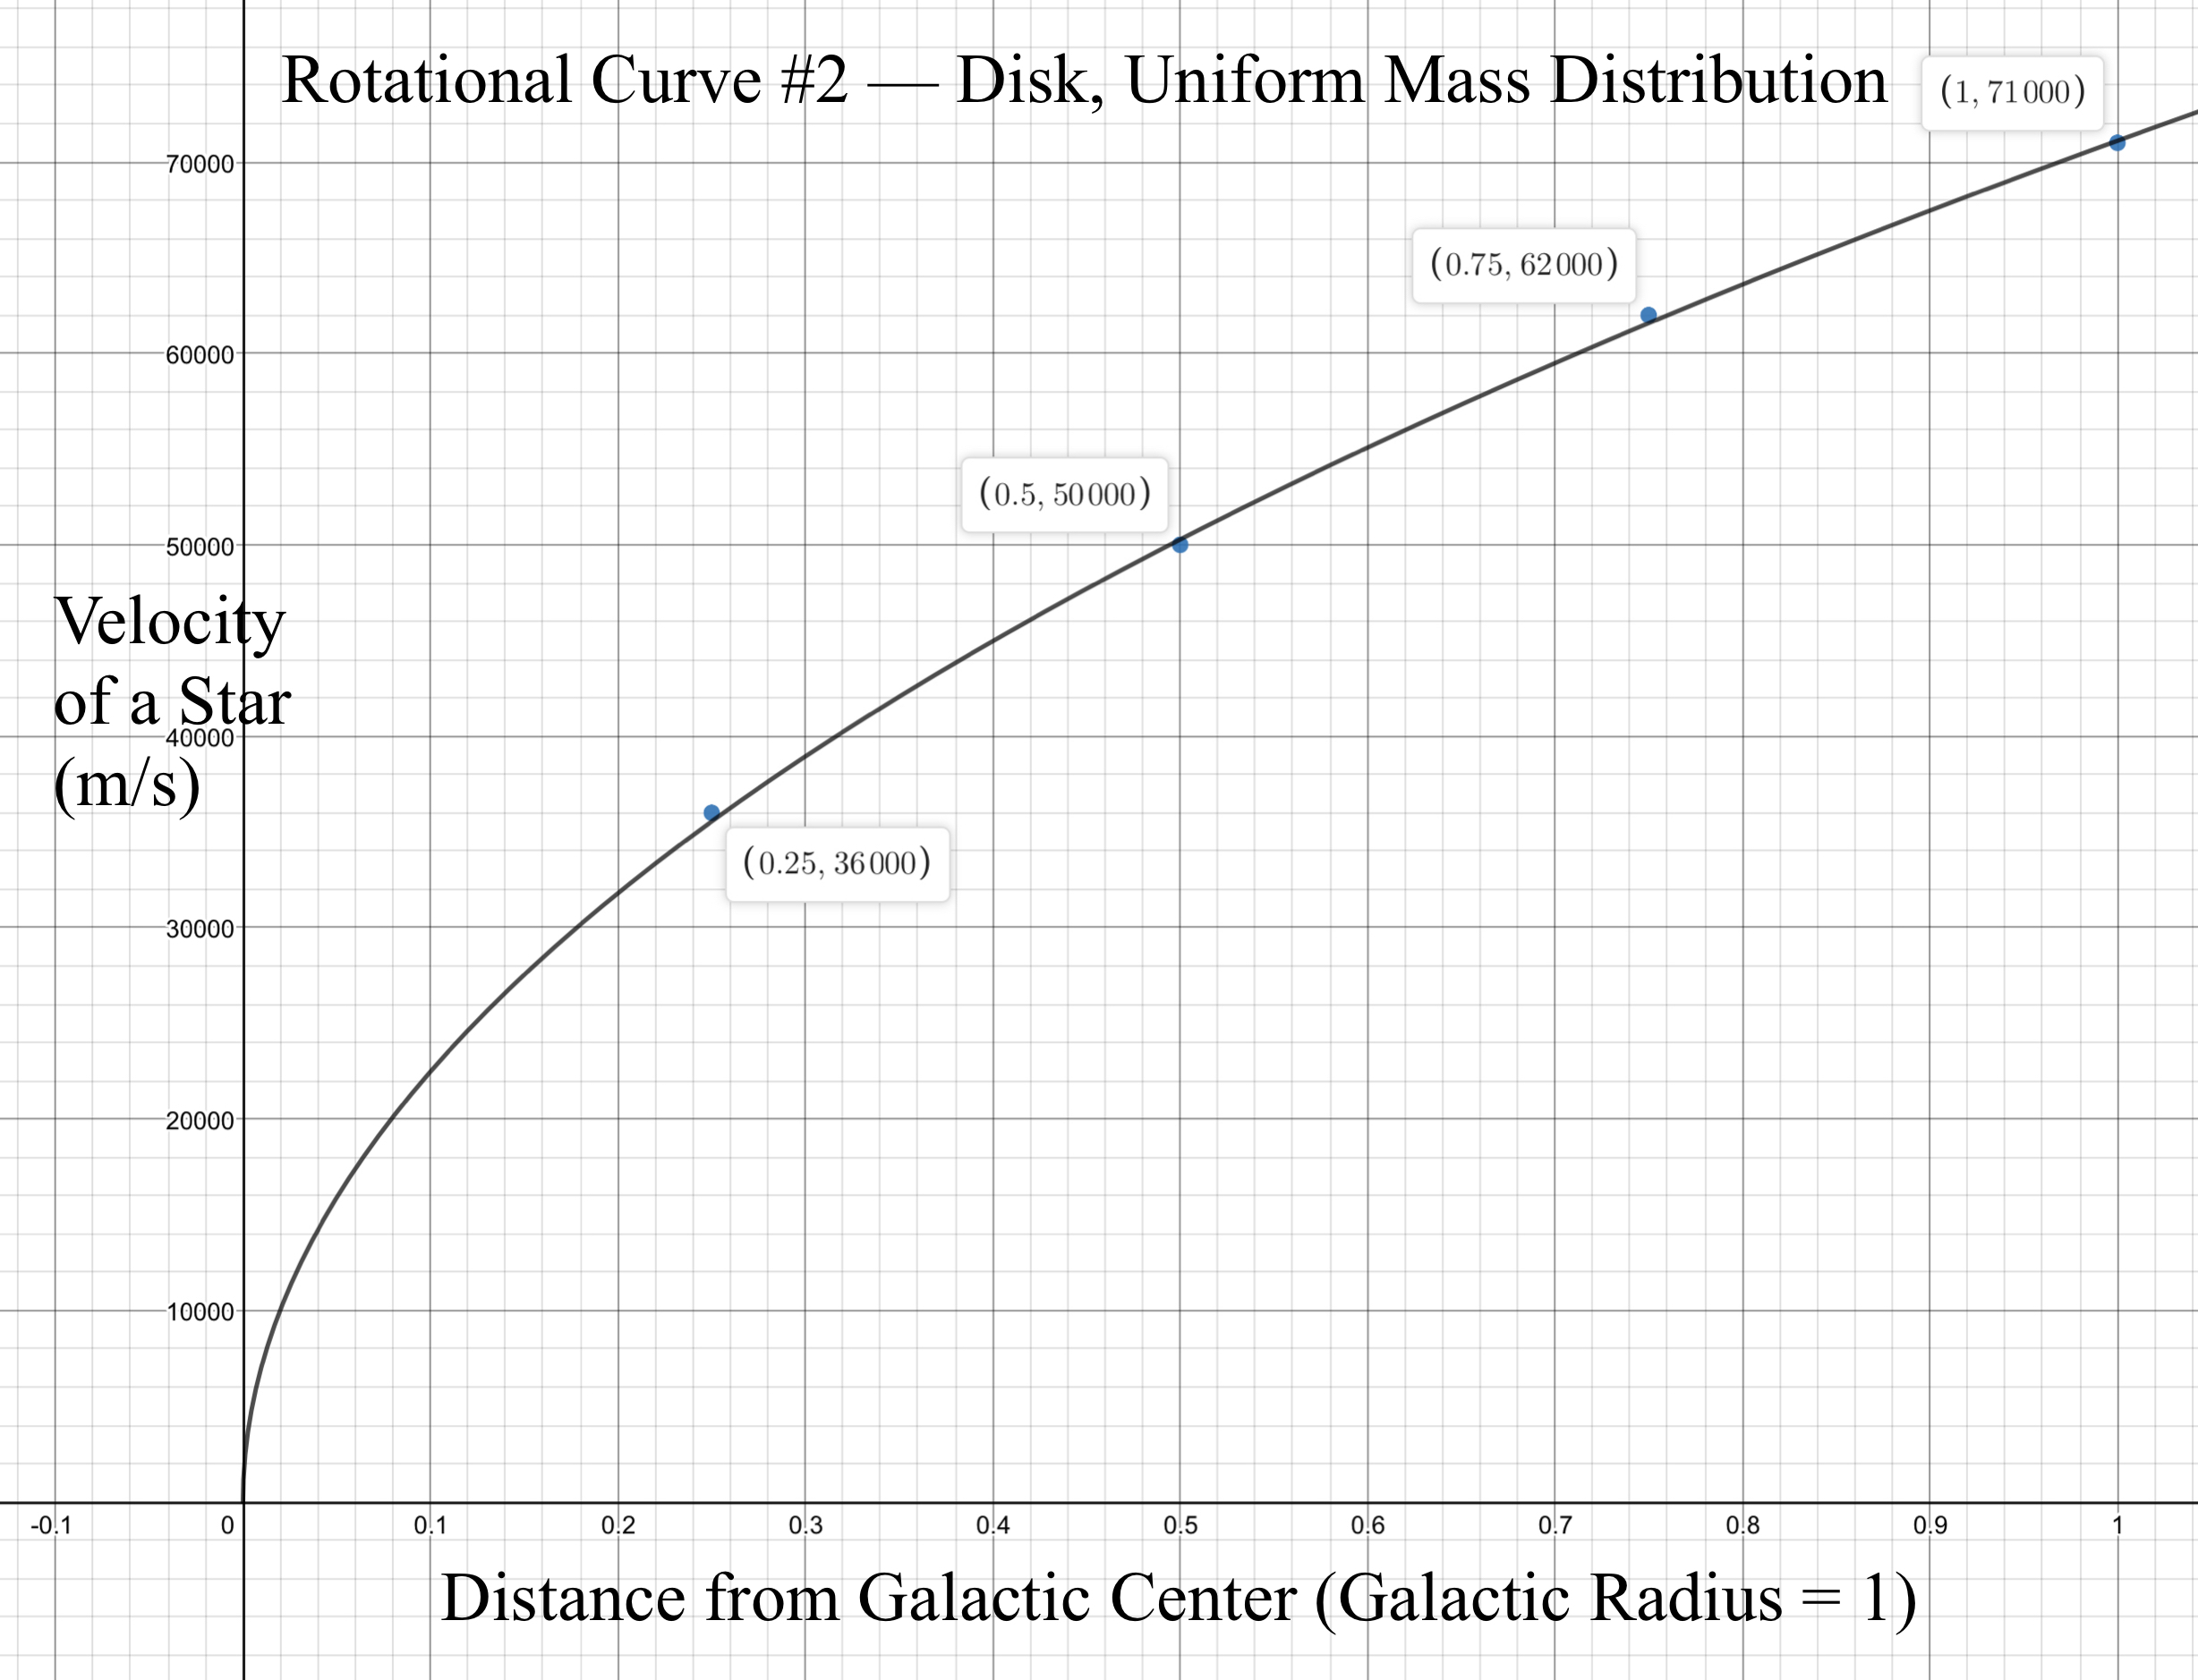




Model B
Same as A, except this time we assume mass is evenly distributed (flat disc)
This calls for the matter density of galaxy
S
Use same equation as Model A, but replace M with a new equation (mass as a function of radius, think of Shell Theorem)
This yields a rotational curve as such, where the velocity is directly proportional to the square root of the distance from the galactic center.
Model B is supposed to demonstrate a curve for the flat, uniform distribution of normal matter in a galaxy, even though it’s actually dark matter that is distributed uniformly

Slide 6
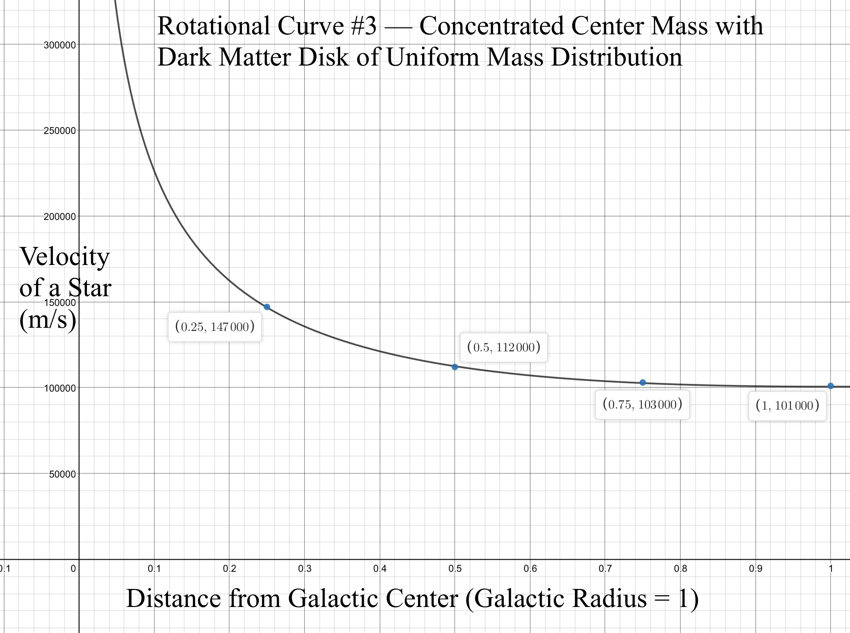

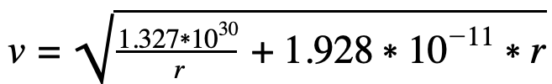
Model D
Combine Models A and B → a galaxy with 10¹⁰ solar masses located at the center, but with another unseen 10¹⁰ solar masses distributed throughout the galaxy
The extra mass represents dark matter
Mass as a function of radius gives:
Substituting this equation for M into the general equation relating centripetal and gravitational force and solving for v gives:
- Bodies near the galactic center orbit rapidly
- Velocity initially decreases, in line with Model A
- At 50-75% of the radius, the forces are comparable
- Orbital velocities level off, more in line with Model B
- Model D is an effective combination of the two other models
- Represents the observed data far more accurately
- Direct evidence for the existence of dark matter

Slide 7
Any Questions?

